Slide 1

FOOD CONSUMPTION PATTERN
Presented by: Priyanka Smart
Sanchal Sunil Dhurve
Prathyusha Vutukuri
Charmi Patel
Kapil Katrodiya

Slide 2
CONTENT :
Objectives
Overview of Questions
Methodology
Interpretation

Slide 3
OBJECTIVE: To identify trends and patterns in daily calorie intake.
To determine the impact of various factors on individuals' health and well-being.
Dependent variable (response variable) - daily calorie intake
The list of independent variables is:
Age: Age of the individual (Range – 18-60 in years).
Gender: Gender of the individual (Male/Female).
Weight (in kilograms)
Dietary Preference: Dietary preference of the individual (Vegetarian/Non-vegetarian/Vegan).
Exercise Frequency: Frequency of exercise per week (Low/Medium/High).
Eating disorder habits: People having eating disorder habits (binge eating/ restrictive eating/no)
Location: People residing in various cities in Illinois state.
The sample size (n) is 2000.

Slide 4
Overview of Questions:
1.How does weight depend upon the calorie intake based upon age?
2. Is there a significant difference in daily calorie intake between different age groups?
3. Considering potential variations in the personalized food choices, how does gender affect daily calorie intake?
4. Are there interaction effects between certain independent variables (e.g. dietary preference, exercise frequency, location, eating disorder habits such as binge-eating or restrictive eating patterns) on daily caloric intake?
5. What can we interpret about all the independent variables having an influence on the daily calorie intake and individuals’ food preferences?

Slide 5
Q1) How does weight depend upon the calorie intake based upon age?
Variables used: Response variable- daily calorie intake, independent variables- Weight, Age.
Techniques: Linear Regression Analysis with Interaction term.
Interaction term- ageweight
daily_caloric_intake_dataset $ ageweight <-daily_caloric_intake_dataset$Age*daily_caloric_intake_dataset$Weight
mod1 <- lm(Daily.Caloric.Intake~ageweight, data = daily_caloric_intake_dataset)
summary(mod1)

Slide 6
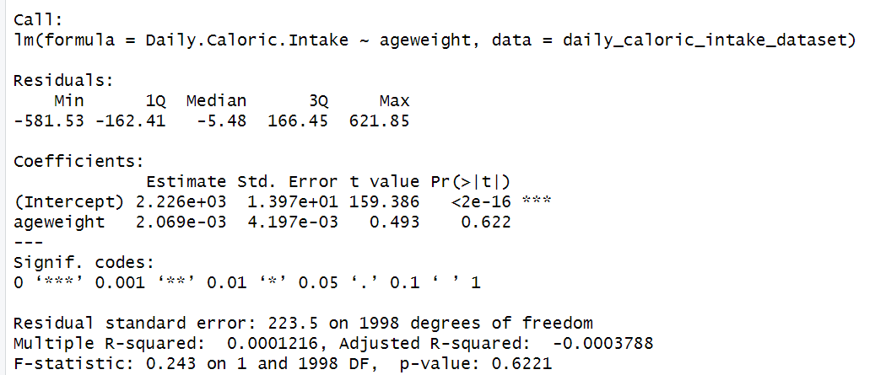
summary(mod1)
Interpretation:
Adjusted R squared value = -0.00037 The predictor does not improve the model fit.
F-statistic - 0.243 and p-value is 0.622- not significant.
The interaction term does not have significant effect on the model

Slide 7
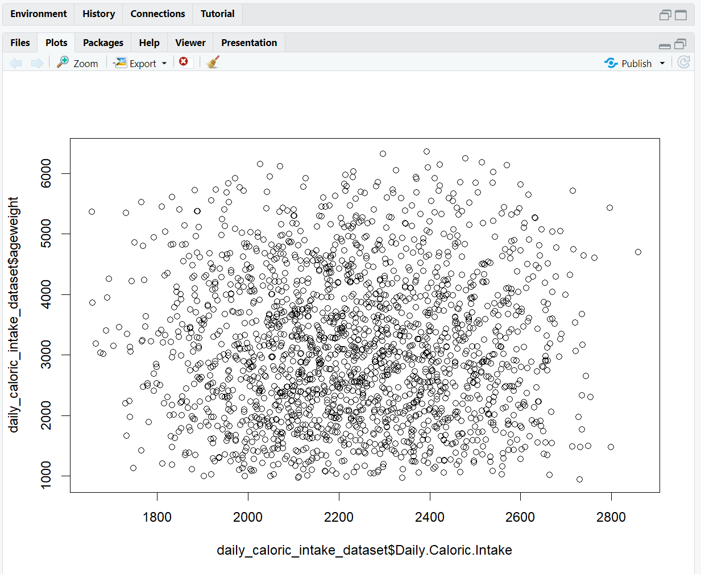
plot(daily_caloric_intake_dataset$Daily.Caloric.Intake, daily_caloric_intake_dataset$ageweight)
Interpretation:
The plot is between response variable and the interaction term.
By analyzing the module, it is observed that it is not a significant model and needs more analysis. The plot is randomly scattered across the horizontal and vertical axis.
Further analysis can be performed by applying the residual analysis to the model with respect to the predicted values.

Slide 8
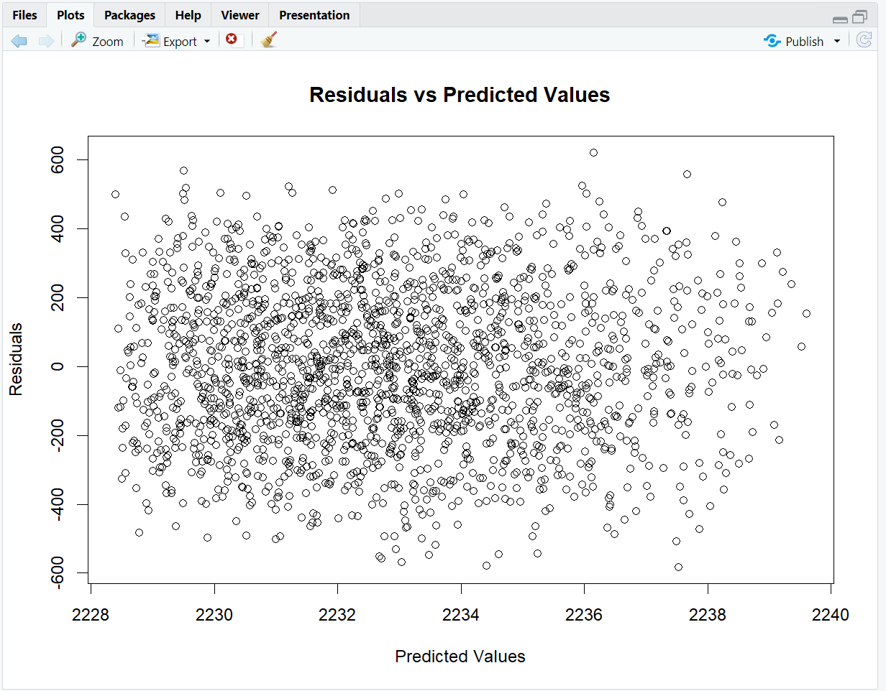
Residual Analysis
predictval = predict(mod1)
residuals <- mod1$residuals
plot(predictval, residuals, xlab = "Predicted Values",
ylab = "Residuals", main = "Residuals vs
Predicted Values")
Interpretation:
The residuals are randomly scattered around the horizontal axis in indicating asymmetric.
The spread of residuals is consistent with respect to the predicted values which suggests that the variance is constant.
There seems to be no curve or bell-shaped obtained indicating that the residual plot does not follow any specific trend and likely satisfies the linearity assumption.

Slide 9
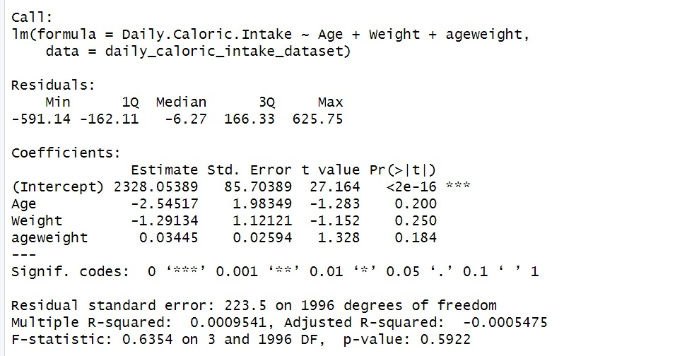

> summary(mod4)
Check for multicollinearity:
mod4 <- lm(Daily.Caloric.Intake~ Age+ Weight+ ageweight, data = daily_caloric_intake_dataset)
summary(mod4)
vif_val <- vif(mod4)
print(vif_val)

Slide 10
Interpretation:
The VIF values indicate that there is indeed multicollinearity between age, weight and daily calorie intake.
The obtained values are greater than 10 which suggests that there is multicollinearity and needs to analyze. There can be several reasons for multicollinearity.
It can make difficult to analyze each predictor and it’s significant effect on the response variable.
It can be concluded that both age weight together does not have significant effect on the response variable. The interaction term gives a high multicollinearity values indicating that the simple linear regression model is more effective than the interaction term.
Incorporating the interaction term, increases the error and prediction values also contain noises if not removed at the right time.

Slide 11
Q2. Is there a significant difference in daily calorie intake between different age groups?
Variables used:
Response variable- daily calorie intake, Independent variable- Age
Techniques: 1. ANOVA-Analysis of Variance.
> anova_model <- aov(Daily.Caloric.Intake ~ Age, data = daily_caloric_intake_dataset)
> summary(anova_model)
Interpretation: Age Does Not Affect Calorie Intake Significantly:
High p-value (0.907): Shows no significant difference in calorie intake between age groups.
Low F-value (0.014): Indicates age doesn't explain much of the variation in calorie intake.
This result implies that Age does not have a substantial effect on Daily Caloric Intake in the dataset. The specific effect size (difference in means) is so small that it is not statistically significant.

Slide 12
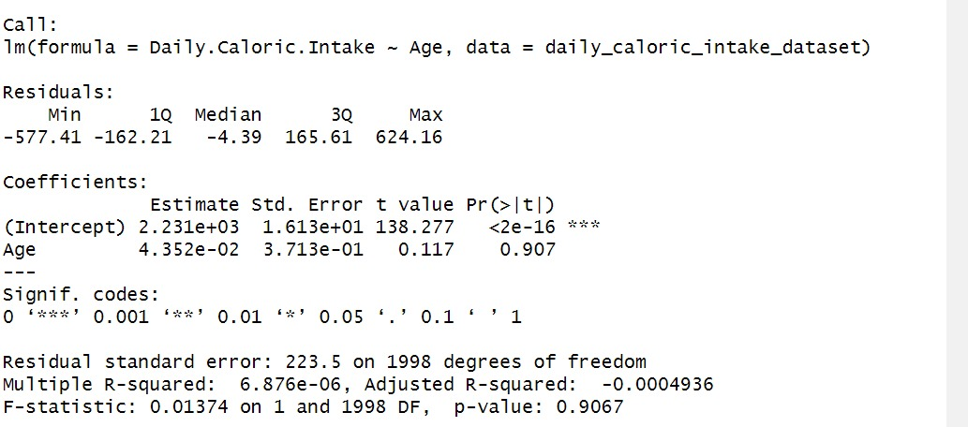
> summary(model2)
2. Residual Analysis
> model2 <- lm(Daily.Caloric.Intake ~ Age, data = daily_caloric_intake_dataset)
> summary(model2)
> residuals <- model2$residuals
> predicted_val = predict(model2)
> plot(predicted_val, residuals, xlab = "Predicted Values", ylab = "Residuals", main = "Residuals vs Predicted Values")

Slide 13
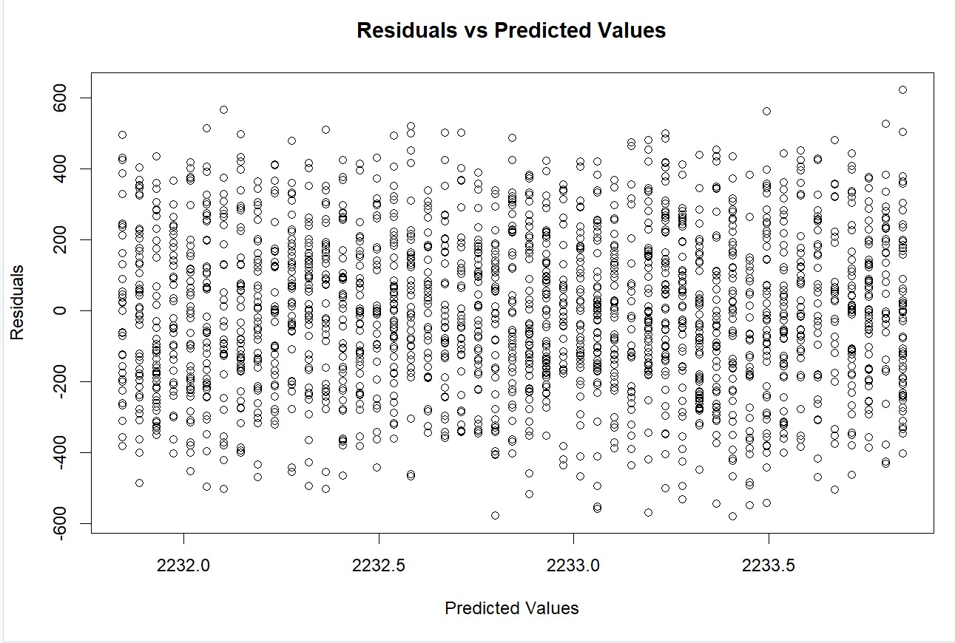
Interpretation:
Random Distribution: No clear pattern, so the model
doesn't have bias.
Consistent Spread: Errors are spread out evenly,
meaning the model's predictions are reliable.
No Clear Patterns: The model assumptions are likely correct.
From the plot, it is difficult to detect any outliers.

Slide 14
Q3. Considering potential variations in the personalized food choices, how does gender affect the daily calorie intake?
Variables used:
Response variable- daily calorie intake
Independent variable- Gender
Technique: Simple Regression Analysis
> model <- lm (Daily.Caloric.Intake ~ Gender, data = daily_caloric_intake_dataset)
> summary(mod1)
Residual Analysis
> predictval <- predict(mod1)
> residuals <- mod1$residuals
> hist(model$residuals, breaks = 100)

Slide 15
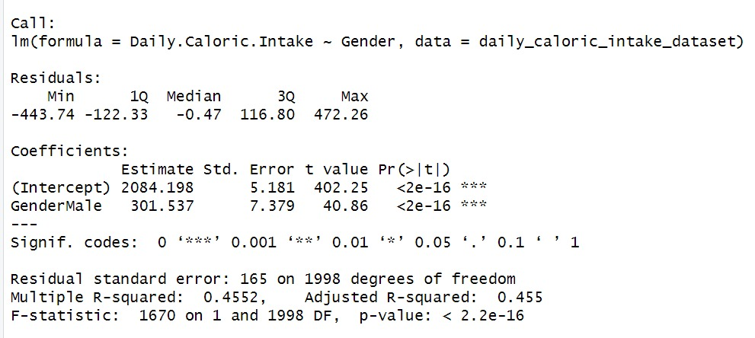
Interpretation:
Adjusted R-squared: 0.455
p-value: < 2.2e-16
A very large F-statistic with a p-value less than 2.2e-16 indicates that the model is highly significant.
The model indicates that gender is a significant predictor of daily caloric intake.
Males consume on average 301.537 more calories per day than females.
The model explains 45.52% of the variance in daily caloric intake.

Slide 16
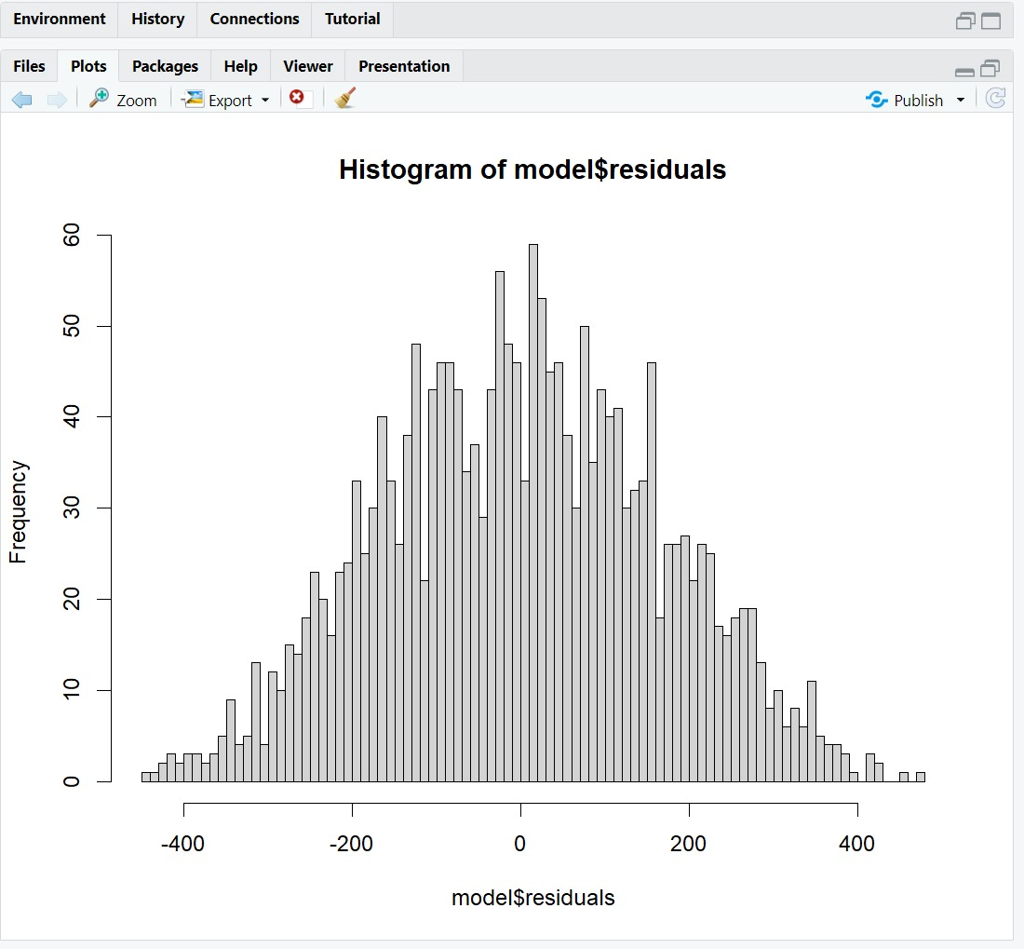
Interpretation of the Histogram of Residuals:
Symmetry: The histogram appears to be relatively symmetric around the center (mean residual close to zero).
Center: The residuals are centered around zero.
Spread: The residuals are spread out but have a higher
frequency closer to the center (mean).
Outliers: There are some residuals beyond ±400, but they
are relatively few. These points could be considered
outliers.
Normality: The bell-shaped curve of the histogram
suggests that the residuals follow a normal distribution,
which is an important assumption in linear regression.
In simple regression analysis, checking for multicollinearity
can not be done since there is only one predictor variable.

Slide 17
Q4. Are there interaction effects between certain independent variables (e.g., dietary preference, exercise frequency, location, eating disorder habits) on daily caloric intake?
Variables Used:
Response Variable- Daily Caloric Intake
Independent Variables- Dietary Preference, Exercise Frequency, Location, Eating Disorder Habits
Techniques:
1. Backward Selection
> library(MASS)
> mod3 <- lm(Daily.Caloric.Intake Dietary.Preference + Exercise.Frequency + Location+ Eating.Disorder.Habit, data= daily_caloric_intake_dataset)
> summary(mod3)
> step <- stepAIC(mod3, direction = "backward")
> summary(step)
> step$anova

Slide 18
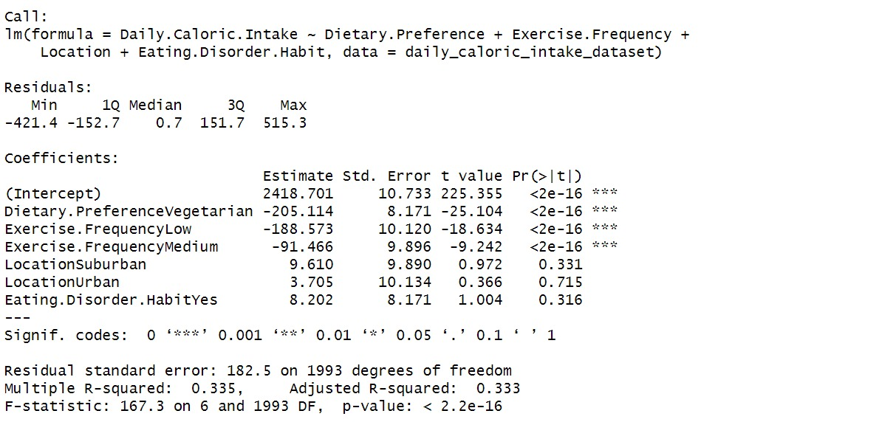
> summary(mod3)
Interpretation:
Model Performance:
R-squared: 0.335
Adjusted R-squared: 0.333
F-statistic: 167.3 (p < 0.05)
The initial regression analysis reveals that being vegetarian and having low or medium exercise frequency significantly reduce daily caloric intake, while location and eating disorder habits show no significant effect.
The model explains 33.5% of the variance in daily caloric intake (R-squared = 0.335) and is statistically significant (F-statistic = 167.3, p < 2.2e-16).

Slide 19
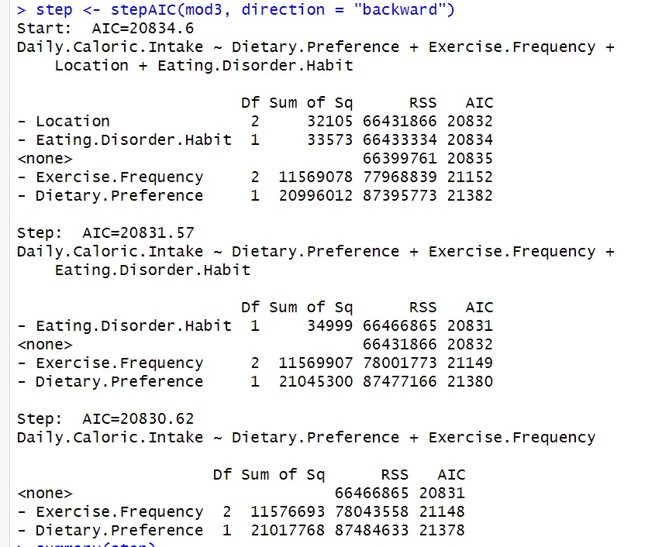
> step <- stepAIC(mod3, direction = "backward")
Interpretation:
Lower AIC indicates a better balance between model fit and complexity.

Slide 20
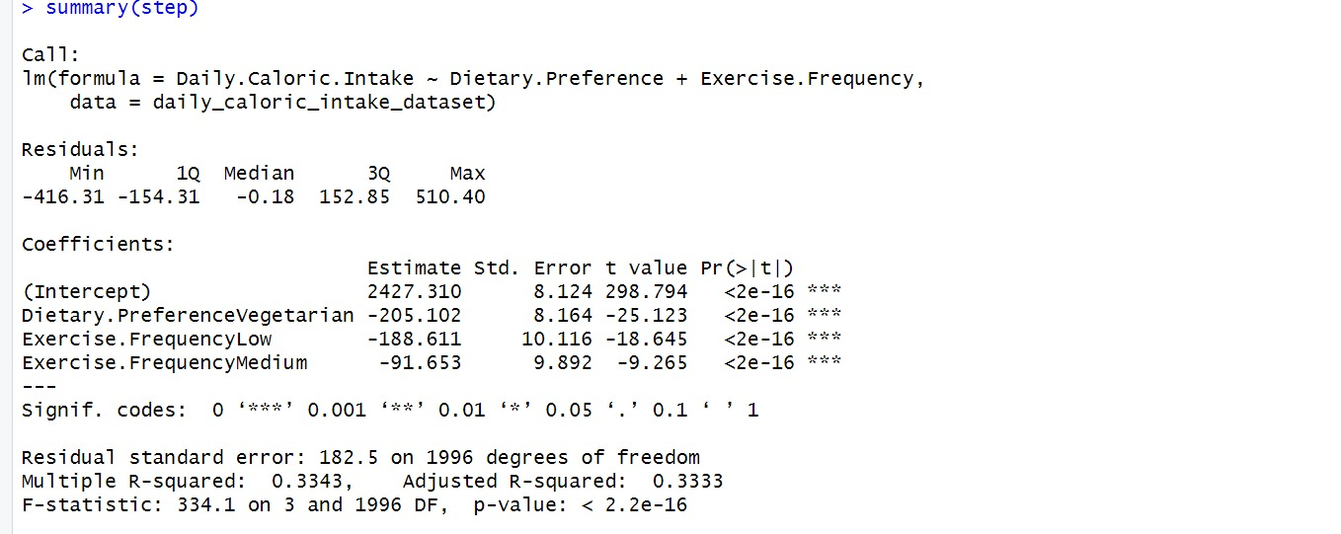
> summary (step)
Model Performance:
R-squared: 0.334
Adjusted R-squared: 0.333
F-statistic: 334.1 (p < 0.05)

Slide 21
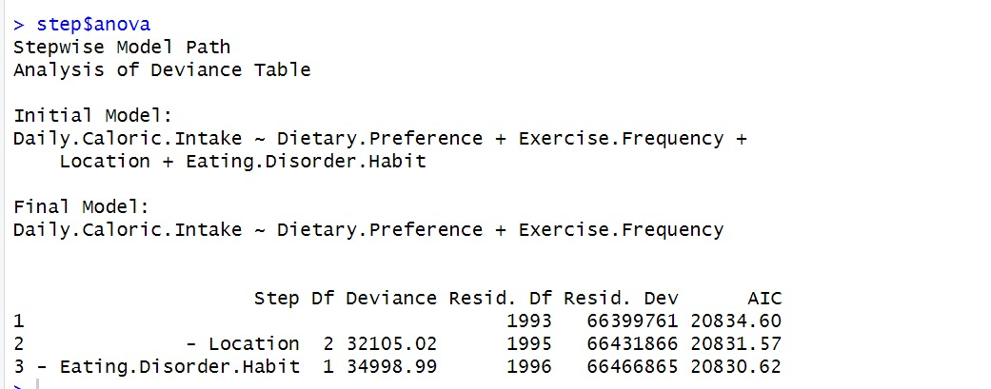
> step$anova
AIC Comparison:
Results:
Initial Model AIC: 20834.6
Final Model AIC: 20830.62
Conclusion: The final model exhibits improved
efficiency with a lower AIC.

Slide 22
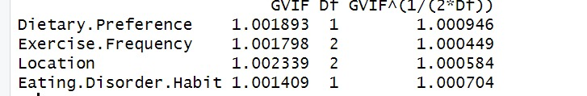
Check for multicollinearity:
vif_values <- vif(mod3)
print(vif_values)
Results:
VIF Values:
Dietary Preference: 1.0019
Exercise Frequency: 1.0018
Location: 1.0023
Eating Disorder Habit: 1.0014
Interpretation: All VIF values are close to 1, indicating low multicollinearity.
Conclusion:
No significant multicollinearity observed among predictor variables.
The final model achieves a better balance between fit and complexity, as indicated by the lower AIC.

Slide 23
Q5. What can we interpret about all the independent variables having an influence on the daily calorie intake and individuals’ food preferences?
As per the final results, we can conclude that the age and weight does have a significant effect on the response variable. However, the interaction term does not provide accurate result and affecting the overall model performance, so instead of considering a together effect of age and weight, the individual effect can be considered to get a better performance of the model.
The model indicates that gender is a significant predictor of daily caloric intake. Males consume on average 301.537 more calories per day than females.
After performing the backward selection technique, the final model consists of dietary preference and exercise frequency, thereby being significant.
The independent variables gender, dietary preference and exercise frequency have the most effect on the daily calorie intake in a person's body. The daily calorie intake differs for male and female which can be further assessed. Exercise frequency and dietary preference also affects the daily calorie intake.
These findings may provide tailored dietary recommendations and emphasize the significance of taking consideration a variety of factors when determining an individual's daily caloric needs.

Slide 24
THANK YOU!

